Slide 1

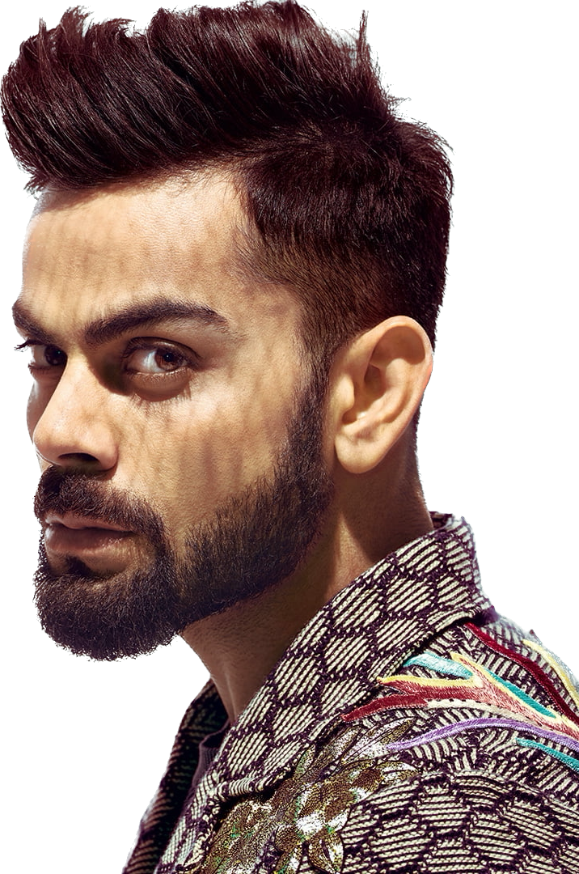

HOME CAREER GALLERY SEEVA ABOUT
I always dreamt of holding the bat and winning games for India. That was my inspiration to take up cricket.
- Virat Kohli

Slide 2


